Slide 1
CHAPTER 4
Propagation, Antennas and Feedlines

Slide 2
Background and concepts

Slide 3
Ionospheric Layers
Notes:
The key points are the D, E and F layers. The F layer splits and becomes F1 and F2 with the additional energy from the daytime sun. The D and E layers disappear at night without the sun’s energy. The D layer absorbs most RF power, particularly at low frequencies. The other layers will reflect RF energy. The higher the layer, the further the contact possible.
Propagation conditions are a balance between the D layer absorption of lower frequencies and the reflection of the higher frequencies by the upper layers. As more of the sun’s energy (primarily electromagnetic and particle emissions) strikes the ionosphere, all the layers grown in size and density. The D layer will absorb more low frequency RF and the upper layers will reflect more high frequency RF. This creates a window of frequencies above the Lowest Usable Frequency (LUF) and Maximum Usable Frequency (MUF) that will work for long distance communications.
Sunspots provide huge amounts of energy to reflect radio waves in the ionosphere and are especially important in the upper bands. The sun rotates (solar day) every 28 days. This means if conditions are good on one day, they are likely to repeat 28 days later when the earth is in the same position.
Because the sun is so critical for communications, measurements are constantly being made of the “Solar Flux” (RF energy emitted by the sun). In the US, WWV broadcasts reports with the “Solar Flux Index” (a measure of solar activity that is taken at a specific frequency) every hour.

Slide 4
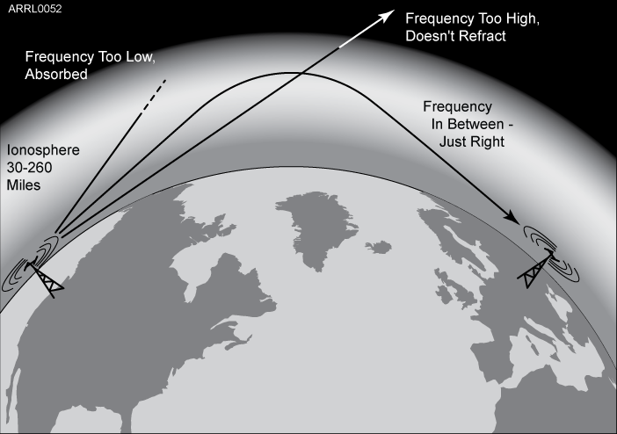
IONOSPHERIC REFRACTION

Slide 5
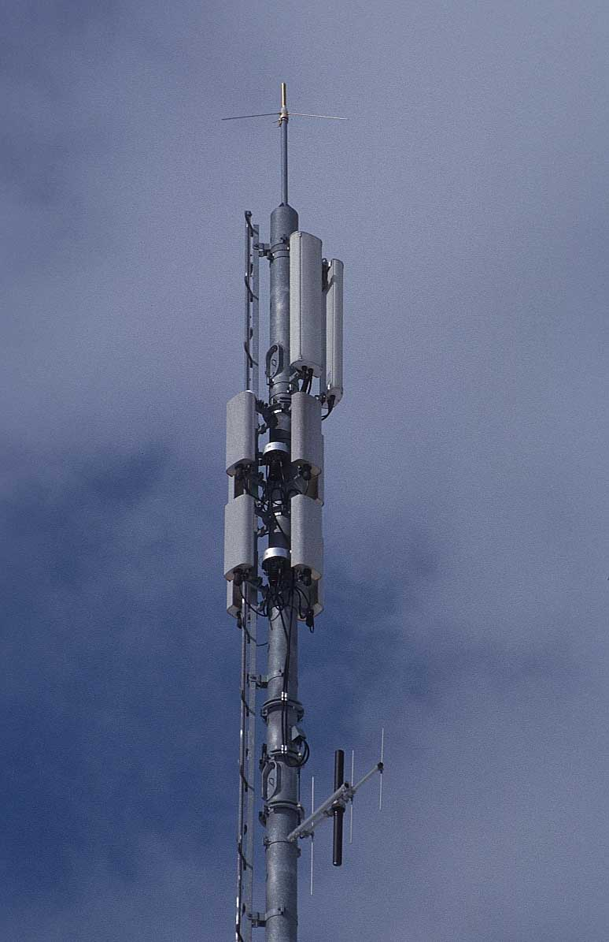
Antenna Classifications
Orientation
Horizontal – parallel to the Earth
Vertical – perpendicular to the Earth
Directivity (Beam)
Yagi, Log Periodic, Quad, Dish
Size
Wavelength – λ
½ λ, ¼ λ, ⅝ λ, …
Notes:
Antennas can be classified in any number of ways. For example their orientation, size, shape. We can also classify them by and operation parameter such as gain, directivity, impedance. We can also arrange them by physical properties line flexible, shortened, loaded, active, etc. There are lots of ways to classify them.
For the test, there are three thing we care about: Orientation, Directivity and Size.

Slide 6
Horizontal Antennas Half Wavelength Dipole Antenna)
Half wavelength from formula
Solder
Spacer
Open wire feeder
Half wavelength
300
F (MHz)
Wavelength (meters) =
Meters to inches
½λ Dipole length (inches) = Wavelength / 2 x 39
Notes:
The actual physical length will be slightly smaller because electron flow through a conductor is slower than the speed of light. This decrease in speed is called “velocity factor” and is expressed as a percentage. Copper has a velocity factor near 95 or 95% of the speed of light. That also means an antenna made of copper will be about 95% the size of the theoretical value above.

Slide 7
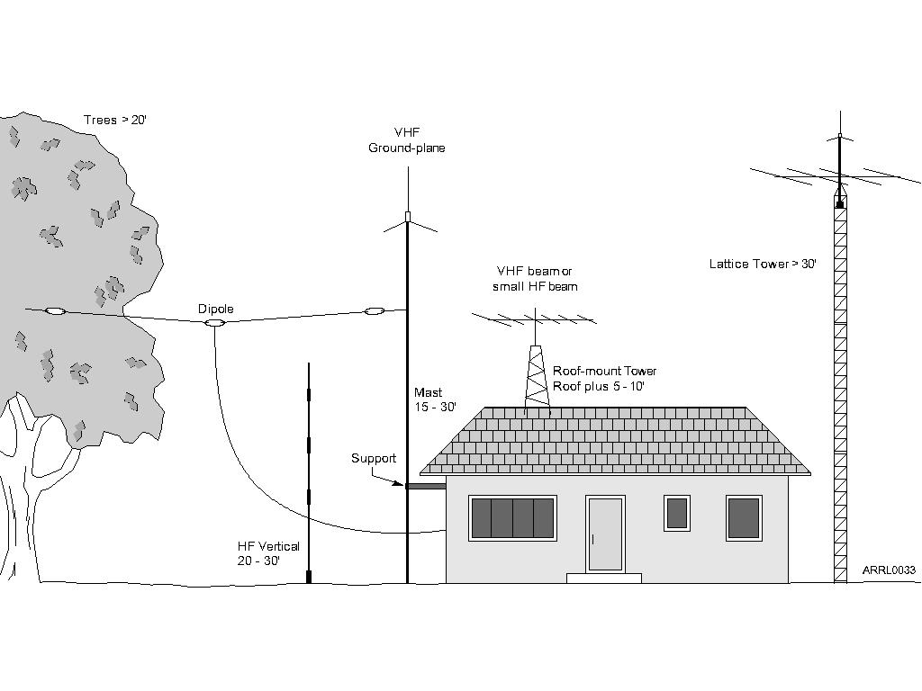

Slide 8
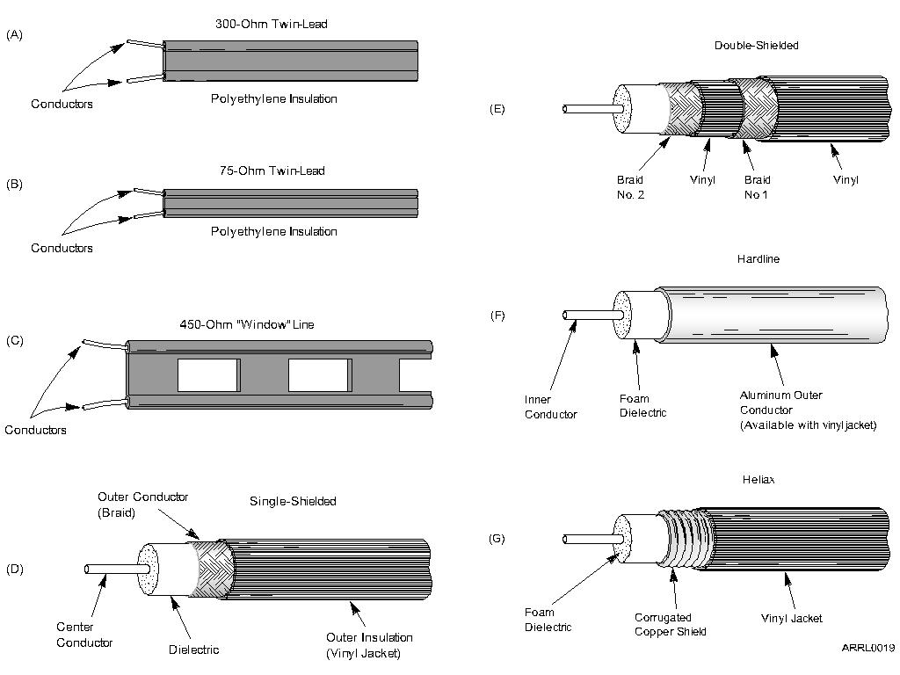

Slide 9
Propagation Refraction Diffraction
Radio waves travel in straight lines
(more or less)

Slide 10
Refraction
Radio waves curve if media is not uniform
Radio waves curve around optical horizon
In extreme cases radio waves can get trapped

Slide 11
Refraction Waves appear to bend Top of wave travels faster than bottom
T

Slide 12
Diffraction
Radio waves can bend around obstacles
Buildings
Ridges

Slide 13
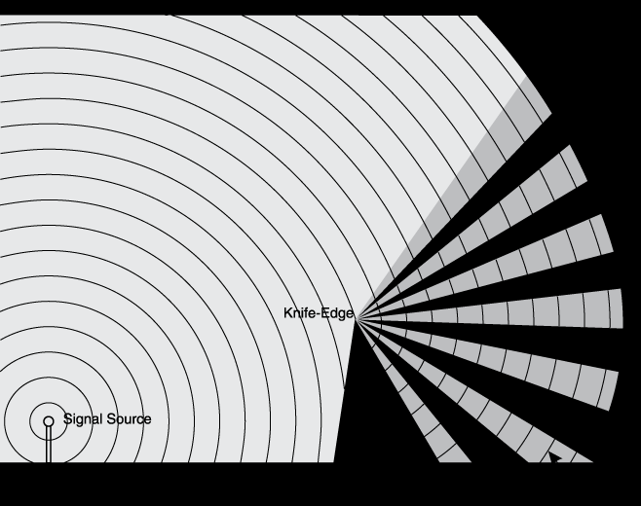

Slide 14
½ λ Dipole Radiation
Radiation pattern for a dipole placed ½ λ
above ground looking down from above the antenna.
Looks like a doughnut around the wire in 3D space.
Pattern distorts to omnidirectional when placed low to the ground.
Notes:
A dipole is a a half wavelength piece of wire connected at the center (1/4 wave on each side). If the dipole antenna was the red line, the lobes above and below show the radiation pattern at ½ wavelength above the ground. This pattern actually rotates around the wire like a donut. As the antenna is lowered below ½ wavelength, the lobes flatten until it becomes nearly omnidirectional.

Slide 15
Vertical Antennas (Quarter Wavelength Vertical)
Radials
Ground Plane
Ground
Marconi
Ground Plane
Quarter wavelength
300
F (MHz)
Wavelength (meters) =
Meters to inches
¼λ vertical length (inches) = Wavelength / 4 x 39
Notes:
The actual physical length will be slightly smaller because electron flow through a conductor is slower than the speed of light. This decrease in speed is called “velocity factor” and is expressed as a percentage. Copper has a velocity factor near 95 or 95% of the speed of light. That also means an antenna made of copper will be about 95% the size of the theoretical value above.

Slide 16
Quarter Wave Vertical Radiation
Perfect Ground
Average Ground

Elevation
Maximum Radiation Angle
0 dB= 5.10 dBi
7.150 MHz
A side view of the radiation pattern of a 1/4 wave vertical. From above the pattern is round like a doughnut. A perfect ground would be the center of a metal car roof at VHF/UHF.
Notes:
Notice how ground affects the performance of the system. Over an average ground the maximum strength is 6dB less (4 fold) and has a higher radiation angle.

Slide 17
Beam Antennas (Yagi Antenna)
The reflector
acts like a
mirror
Driven Element
The director
acts like a
lens
Boom
Gain
Reflector
Director
Feedline
Notes:
Note the driven element with the balun attached, the smaller directors, larger reflector and the pattern with a large front lobe. The driven element is approximately a half have dipole. As parasitic elements (directors and reflectors) are added and the boom length is increased, the more gain is provided by the antenna. Reflectors are placed behind the driven element to reflect the power forward and the directors act as conductors in front of the wave. Reflectors are generally ~3% longer than the driven element and directors ~3% shorter. Five element yagis like this one yield 10-12dB gain over a dipole, based on the design of the antenna.
Antenna designers have to balance forward gain, front-to-back ratio, bandwidth and feedpoint impedance when designing an antenna. Some antennas will be optimized for maximum forward gain to improve their output and others may have better front-to-back rations to improve their noise rejection. Antenna bandwidth can be increased by using larger diameter elements. Gain is largely a function of boom length.

Slide 18
Yagi Radiation Pattern
The yagi antenna focuses RF energy in one direction, giving the appearance of
getting “free power.”
This free power or Effective Radiated Power (ERP) can be expressed as antenna Gain in Decibels (dB) over a dipole (dBd) or isotropic resonator (dBi).
Notes:
An isotropic resonator is an imaginary point in free space that radiates equally well in all directions. Since this isn’t an a physical antenna and the “performance” is poor, manufacturers often use it for comparison. To convert dBi to dBd, subtract 2.15 dB from the dBi value. If a manufacturer publishes dBd values, they are likely honest values because they’re lower.

Slide 19
Load Matching
Amateur transceivers have a 50 ohm output impedance
Coax and antennas should be as close to 50 ohms as possible to insure maximum power transfer
Any mismatch creates “standing waves” that can be measured with an SWR or directional watt meter
An SWR of 1:1 indicates perfect power transfer
As SWR increases above 2:1, modern transmitters will automatically reduce output to protect from damage
All feed lines have “loss” that increases with frequency and length caused by resistance in the line
Standing waves will eventually be either radiated or lost as heat in the feed line
Notes:
The 50 ohm impedance is important because it means using 75 ohm TV coax will cause a (small) impedance mismatch. Larger differences, like those from twin lead and ladder line, require a transformer to allow a proper match.

Slide 20
Standing Waves
Notes:
Waves traveling through a transmission line will continue until they meet an obstruction – a change in impedance. An open or short will result in the complete reflection of the wave shown above. This would create a perfect standing wave. In cases where there is simply an impedance mismatch, only some of the energy would be reflected creating smaller standing waves. These standing waves are energy lost, although whatever isn’t lost in the feed line will eventually will reflect and radiate.

Slide 21
T3A01 What should you do if another operator reports that your station's 2 meter signals were strong just a moment ago, but now they are weak or distorted?
A. Change the batteries in your radio to a different type
B. Turn on the CTCSS tone
C. Ask the other operator to adjust his squelch control
D. Try moving a few feet, as random reflections may be causing multi-path distortion

Slide 22
T3A01 What should you do if another operator reports that your station's 2 meter signals were strong just a moment ago, but now they are weak or distorted?
A. Change the batteries in your radio to a different type
B. Turn on the CTCSS tone
C. Ask the other operator to adjust his squelch control
D. Try moving a few feet, as random reflections may be causing multi-path distortion

Slide 23
T3A02 Why are UHF signals often more effective from inside buildings than VHF signals?
A. VHF signals lose power faster over distance
B. The shorter wavelength allows them to more easily penetrate the structure of buildings
C. This is incorrect; VHF works better than UHF inside buildings
D. UHF antennas are more efficient than VHF antennas

Slide 24
T3A02 Why are UHF signals often more effective from inside buildings than VHF signals?
A. VHF signals lose power faster over distance
B. The shorter wavelength allows them to more easily penetrate the structure of buildings
C. This is incorrect; VHF works better than UHF inside buildings
D. UHF antennas are more efficient than VHF antennas

Slide 25
T3A06 What term is commonly used to describe the rapid fluttering sound sometimes heard from mobile stations that are moving while transmitting?
A. Flip-flopping
B. Picket fencing
C. Frequency shifting
D. Pulsing

Slide 26
T3A06 What term is commonly used to describe the rapid fluttering sound sometimes heard from mobile stations that are moving while transmitting?
A. Flip-flopping
B. Picket fencing
C. Frequency shifting
D. Pulsing

Slide 27
T3A08 Which of the following is a likely cause of irregular fading of signals received by ionospheric reflection?
A. Frequency shift due to Faraday rotation
B. Interference from thunderstorms
C. Random combining of signals arriving via different paths
D. Intermodulation distortion

Slide 28
T3A08 Which of the following is a likely cause of irregular fading of signals received by ionospheric reflection?
A. Frequency shift due to Faraday rotation
B. Interference from thunderstorms
C. Random combining of signals arriving via different paths
D. Intermodulation distortion

Slide 29
T9A10 In which direction is the radiation strongest from a half-wave dipole antenna in free space?
A. Equally in all directions
B. Off the ends of the antenna
C. Broadside to the antenna
D. In the direction of the feed line

Slide 30
T9A10 In which direction is the radiation strongest from a half-wave dipole antenna in free space?
A. Equally in all directions
B. Off the ends of the antenna
C. Broadside to the antenna
D. In the direction of the feed line

Slide 31
T3A10 What may occur if data signals propagate over multiple paths?
A. Transmission rates can be increased by a factor equal to the number of separate paths observed
B. Transmission rates must be decreased by a factor equal to the number of separate paths observed
C. No significant changes will occur if the signals are transmitting using FM
D. Error rates are likely to increase

Slide 32
T3A10 What may occur if data signals propagate over multiple paths?
A. Transmission rates can be increased by a factor equal to the number of separate paths observed
B. Transmission rates must be decreased by a factor equal to the number of separate paths observed
C. No significant changes will occur if the signals are transmitting using FM
D. Error rates are likely to increase

Slide 33
T3C05 Which of the following effects might cause radio signals to be heard despite obstructions between the transmitting and receiving stations?
A. Knife-edge diffraction
B. Faraday rotation
C. Quantum tunneling
D. Doppler shift

Slide 34
T3C05 Which of the following effects might cause radio signals to be heard despite obstructions between the transmitting and receiving stations?
A. Knife-edge diffraction
B. Faraday rotation
C. Quantum tunneling
D. Doppler shift

Slide 35
T3C06 What mode is responsible for allowing over-the-horizon VHF and UHF communications to ranges of approximately 300 miles on a regular basis?
A. Tropospheric scatter
B. D layer refraction
C. F2 layer refraction
D. Faraday rotation

Slide 36
T3C06 What mode is responsible for allowing over-the-horizon VHF and UHF communications to ranges of approximately 300 miles on a regular basis?
A. Tropospheric scatter
B. D layer refraction
C. F2 layer refraction
D. Faraday rotation

Slide 37
T3C10 What is the radio horizon?
A. The distance over which two stations can communicate by direct path
B. The distance from the ground to a horizontally mounted antenna
C. The farthest point you can see when standing at the base of your antenna tower
D. The shortest distance between two points on the Earth's surface

Slide 38
T3C10 What is the radio horizon?
A. The distance over which two stations can communicate by direct path
B. The distance from the ground to a horizontally mounted antenna
C. The farthest point you can see when standing at the base of your antenna tower
D. The shortest distance between two points on the Earth's surface

Slide 39
T3C11 Why do VHF and UHF radio signals usually travel somewhat farther than the visual line of sight distance between two stations?
A. Radio signals move somewhat faster than the speed of light
B. Radio waves are not blocked by dust particles
C. The Earth seems less curved to radio waves than to light
D. Radio waves are blocked by dust particles

Slide 40
T3C11 Why do VHF and UHF radio signals usually travel somewhat farther than the visual line of sight distance between two stations?
A. Radio signals move somewhat faster than the speed of light
B. Radio waves are not blocked by dust particles
C. The Earth seems less curved to radio waves than to light
D. Radio waves are blocked by dust particles

Slide 41
T3A11 Which part of the atmosphere enables the propagation of radio signals around the world?
A. The stratosphere
B. The troposphere
C. The ionosphere
D. The magnetosphere

Slide 42
Ionospheric Layers
Notes:
The key points are the D, E and F layers. The F layer splits and becomes F1 and F2 with the additional energy from the daytime sun. The D and E layers disappear at night without the sun’s energy. The D layer absorbs most RF power, particularly at low frequencies. The other layers will reflect RF energy. The higher the layer, the further the contact possible.
Propagation conditions are a balance between the D layer absorption of lower frequencies and the reflection of the higher frequencies by the upper layers. As more of the sun’s energy (primarily electromagnetic and particle emissions) strikes the ionosphere, all the layers grown in size and density. The D layer will absorb more low frequency RF and the upper layers will reflect more high frequency RF. This creates a window of frequencies above the Lowest Usable Frequency (LUF) and Maximum Usable Frequency (MUF) that will work for long distance communications.
Sunspots provide huge amounts of energy to reflect radio waves in the ionosphere and are especially important in the upper bands. The sun rotates (solar day) every 28 days. This means if conditions are good on one day, they are likely to repeat 28 days later when the earth is in the same position.
Because the sun is so critical for communications, measurements are constantly being made of the “Solar Flux” (RF energy emitted by the sun). In the US, WWV broadcasts reports with the “Solar Flux Index” (a measure of solar activity that is taken at a specific frequency) every hour.

Slide 43
T3A11 Which part of the atmosphere enables the propagation of radio signals around the world?
A. The stratosphere
B. The troposphere
C. The ionosphere
D. The magnetosphere

Slide 44
T3C01 Why are direct (not via a repeater) UHF signals rarely heard from stations outside your local coverage area?
A. They are too weak to go very far
B. FCC regulations prohibit them from going more than 50 miles
C. UHF signals are usually not reflected by the ionosphere
D. They collide with trees and shrubbery and fade out

Slide 45
T3C01 Why are direct (not via a repeater) UHF signals rarely heard from stations outside your local coverage area?
A. They are too weak to go very far
B. FCC regulations prohibit them from going more than 50 miles
C. UHF signals are usually not reflected by the ionosphere
D. They collide with trees and shrubbery and fade out

Slide 46
T3C02 Which of the following might be happening when VHF signals are being received from long distances?
A. Signals are being reflected from outer space
B. Signals are arriving by sub-surface ducting
C. Signals are being reflected by lightning storms in your area
D. Signals are being refracted from a sporadic E layer

Slide 47
T3C02 Which of the following might be happening when VHF signals are being received from long distances?
A. Signals are being reflected from outer space
B. Signals are arriving by sub-surface ducting
C. Signals are being reflected by lightning storms in your area
D. Signals are being refracted from a sporadic E layer

Slide 48
T3C03 What is a characteristic of VHF signals received via auroral reflection?
A. Signals from distances of 10,000 or more miles are common
B. The signals exhibit rapid fluctuations of strength and often sound distorted
C. These types of signals occur only during winter nighttime hours
D. These types of signals are generally strongest when your antenna is aimed west

Slide 49
T3C03 What is a characteristic of VHF signals received via auroral reflection?
A. Signals from distances of 10,000 or more miles are common
B. The signals exhibit rapid fluctuations of strength and often sound distorted
C. These types of signals occur only during winter nighttime hours
D. These types of signals are generally strongest when your antenna is aimed west

Slide 50
T3C04 Which of the following propagation types is most commonly associated with occasional strong over-the-horizon signals on the 10, 6, and 2 meter bands?
A. Backscatter
B. Sporadic E
C. D layer absorption
D. Gray-line propagation

Slide 51
T3C04 Which of the following propagation types is most commonly associated with occasional strong over-the-horizon signals on the 10, 6, and 2 meter bands?
A. Backscatter
B. Sporadic E
C. D layer absorption
D. Gray-line propagation

Slide 52
T3C07 What band is best suited for communicating via meteor scatter?
A. 10 meters
B. 6 meters
C. 2 meters
D. 70 cm

Slide 53
T3C07 What band is best suited for communicating via meteor scatter?
A. 10 meters
B. 6 meters
C. 2 meters
D. 70 cm

Slide 54
T3C08 What causes tropospheric ducting?
A. Discharges of lightning during electrical storms
B. Sunspots and solar flares
C. Updrafts from hurricanes and tornadoes
D. Temperature inversions in the atmosphere

Slide 55
T3C08 What causes tropospheric ducting?
A. Discharges of lightning during electrical storms
B. Sunspots and solar flares
C. Updrafts from hurricanes and tornadoes
D. Temperature inversions in the atmosphere

Slide 56
T3C09 What is generally the best time for long-distance 10 meter band propagation via the F layer?
A. From dawn to shortly after sunset during periods of high sunspot activity
B. From shortly after sunset to dawn during periods of high sunspot activity
C. From dawn to shortly after sunset during periods of low sunspot activity
D. From shortly after sunset to dawn during periods of low sunspot activity

Slide 57
T3C09 What is generally the best time for long-distance 10 meter band propagation via the F layer?
A. From dawn to shortly after sunset during periods of high sunspot activity
B. From shortly after sunset to dawn during periods of high sunspot activity
C. From dawn to shortly after sunset during periods of low sunspot activity
D. From shortly after sunset to dawn during periods of low sunspot activity

Slide 58
T3C12 Which of the following bands may provide long distance communications during the peak of the sunspot cycle?
A. Six or ten meters
B. 23 centimeters
C. 70 centimeters or 1.25 meters
D. All of these choices are correct

Slide 59
T3C12 Which of the following bands may provide long distance communications during the peak of the sunspot cycle?
A. Six or ten meters
B. 23 centimeters
C. 70 centimeters or 1.25 meters
D. All of these choices are correct

Slide 60
T5B09 What is the approximate amount of change, measured in decibels (dB), of a power increase from 5 watts to 10 watts?
A. 2 dB
B. 3 dB
C. 5 dB
D. 10 dB

Slide 61
T5B09 What is the approximate amount of change, measured in decibels (dB), of a power increase from 5 watts to 10 watts?
A. 2 dB
B. 3 dB
C. 5 dB
D. 10 dB

Slide 62
T5B10 What is the approximate amount of change, measured in decibels (dB), of a power decrease from 12 watts to 3 watts?
A. -1 dB
B. -3 dB
C. -6 dB
D. -9 dB

Slide 63
T5B10 What is the approximate amount of change, measured in decibels (dB), of a power decrease from 12 watts to 3 watts?
A. -1 dB
B. -3 dB
C. -6 dB
D. -9 dB

Slide 64
T5B11 What is the approximate amount of change, measured in decibels (dB), of a power increase from 20 watts to 200 watts?
A. 10 dB
B. 12 dB
C. 18 dB
D. 28 dB

Slide 65
T5B11 What is the approximate amount of change, measured in decibels (dB), of a power increase from 20 watts to 200 watts?
A. 10 dB
B. 12 dB
C. 18 dB
D. 28 dB

Slide 66
T3A04 What can happen if the antennas at opposite ends of a VHF or UHF line of sight radio link are not using the same polarization?
A. The modulation sidebands might become inverted
B. Signals could be significantly weaker
C. Signals have an echo effect on voices
D. Nothing significant will happen

Slide 67
T3A04 What can happen if the antennas at opposite ends of a VHF or UHF line of sight radio link are not using the same polarization?
A. The modulation sidebands might become inverted
B. Signals could be significantly weaker
C. Signals have an echo effect on voices
D. Nothing significant will happen

Slide 68
T3A07 What type of wave carries radio signals between transmitting and receiving stations?
A. Electromagnetic
B. Electrostatic
C. Surface acoustic
D. Magnetostrictive

Slide 69
T3A07 What type of wave carries radio signals between transmitting and receiving stations?
A. Electromagnetic
B. Electrostatic
C. Surface acoustic
D. Magnetostrictive

Slide 70
T3A09 Which of the following is a common effect of "skip" reflections between the Earth and the ionosphere?
A. The sidebands become reversed at each reflection
B. The polarization of the original signal is randomized
C. The apparent frequency of the received signal is shifted by a random amount
D. Signals at frequencies above 30 MHz become stronger with each reflection

Slide 71
T3A09 Which of the following is a common effect of "skip" reflections between the Earth and the ionosphere?
A. The sidebands become reversed at each reflection
B. The polarization of the original signal is randomized
C. The apparent frequency of the received signal is shifted by a random amount
D. Signals at frequencies above 30 MHz become stronger with each reflection

Slide 72
T3B02 What property of a radio wave is used to describe its polarization?
A. The orientation of the electric field
B. The orientation of the magnetic field
C. The ratio of the energy in the magnetic field to the energy in the electric field
D. The ratio of the velocity to the wavelength

Slide 73
T3B02 What property of a radio wave is used to describe its polarization?
A. The orientation of the electric field
B. The orientation of the magnetic field
C. The ratio of the energy in the magnetic field to the energy in the electric field
D. The ratio of the velocity to the wavelength

Slide 74
T3B03 What are the two components of a radio wave?
A. AC and DC
B. Voltage and current
C. Electric and magnetic fields
D. Ionizing and non-ionizing radiation

Slide 75
T3B03 What are the two components of a radio wave?
A. AC and DC
B. Voltage and current
C. Electric and magnetic fields
D. Ionizing and non-ionizing radiation

Slide 76
T5C07 What is a usual name for electromagnetic waves that travel through space?
A. Gravity waves
B. Sound waves
C. Radio waves
D. Pressure waves

Slide 77
T5C07 What is a usual name for electromagnetic waves that travel through space?
A. Gravity waves
B. Sound waves
C. Radio waves
D. Pressure waves

Slide 78
T9A02 Which of the following is true regarding vertical antennas?
A. The magnetic field is perpendicular to the Earth
B. The electric field is perpendicular to the Earth
C. The phase is inverted
D. The phase is reversed

Slide 79
T9A02 Which of the following is true regarding vertical antennas?
A. The magnetic field is perpendicular to the Earth
B. The electric field is perpendicular to the Earth
C. The phase is inverted
D. The phase is reversed

Slide 80
T9A11 What is meant by the gain of an antenna?
A. The additional power that is added to the transmitter power
B. The additional power that is lost in the antenna when transmitting on a higher frequency
C. The increase in signal strength in a specified direction when compared to a reference antenna
D. The increase in impedance on receive or transmit compared to a reference antenna

Slide 81
T9A11 What is meant by the gain of an antenna?
A. The additional power that is added to the transmitter power
B. The additional power that is lost in the antenna when transmitting on a higher frequency
C. The increase in signal strength in a specified direction when compared to a reference antenna
D. The increase in impedance on receive or transmit compared to a reference antenna

Slide 82
T7C07 What happens to power lost in a feed line?
A. It increases the SWR
B. It comes back into your transmitter and could cause damage
C. It is converted into heat
D. It can cause distortion of your signal

Slide 83
T7C07 What happens to power lost in a feed line?
A. It increases the SWR
B. It comes back into your transmitter and could cause damage
C. It is converted into heat
D. It can cause distortion of your signal

Slide 84
T7C12 Which of the following is a common use of coaxial cable?
A. Carrying dc power from a vehicle battery to a mobile radio
B. Carrying RF signals between a radio and antenna
C. Securing masts, tubing, and other cylindrical objects on towers
D. Connecting data signals from a TNC to a computer

Slide 85
T7C12 Which of the following is a common use of coaxial cable?
A. Carrying dc power from a vehicle battery to a mobile radio
B. Carrying RF signals between a radio and antenna
C. Securing masts, tubing, and other cylindrical objects on towers
D. Connecting data signals from a TNC to a computer

Slide 86
T9B02 What is the impedance of the most commonly used coaxial cable in typical amateur radio installations?
A. 8 ohms
B. 50 ohms
C. 600 ohms
D. 12 ohms

Slide 87
T9B02 What is the impedance of the most commonly used coaxial cable in typical amateur radio installations?
A. 8 ohms
B. 50 ohms
C. 600 ohms
D. 12 ohms

Slide 88
T9B03 Why is coaxial cable used more often than any other feed line for amateur radio antenna systems?
A. It is easy to use and requires few special installation considerations
B. It has less loss than any other type of feed line
C. It can handle more power than any other type of feed line
D. It is less expensive than any other types of feed line

Slide 89
T9B03 Why is coaxial cable used more often than any other feed line for amateur radio antenna systems?
A. It is easy to use and requires few special installation considerations
B. It has less loss than any other type of feed line
C. It can handle more power than any other type of feed line
D. It is less expensive than any other types of feed line

Slide 90
T9B05 What generally happens as the frequency of a signal passing through coaxial cable is increased?
A. The apparent SWR increases
B. The reflected power increases
C. The characteristic impedance increases
D. The loss increases

Slide 91
T9B05 What generally happens as the frequency of a signal passing through coaxial cable is increased?
A. The apparent SWR increases
B. The reflected power increases
C. The characteristic impedance increases
D. The loss increases

Slide 92
T9B11 Which of the following types of feed line has the lowest loss at VHF and UHF?
A. 50-ohm flexible coax
B. Multi-conductor unbalanced cable
C. Air-insulated hard line
D. 75-ohm flexible coax

Slide 93
T9B11 Which of the following types of feed line has the lowest loss at VHF and UHF?
A. 50-ohm flexible coax
B. Multi-conductor unbalanced cable
C. Air-insulated hard line
D. 75-ohm flexible coax

Slide 94
T7C03 What, in general terms, is standing wave ratio (SWR)?
A. A measure of how well a load is matched to a transmission line
B. The ratio of high to low impedance in a feed line
C. The transmitter efficiency ratio
D. An indication of the quality of your station’s ground connection

Slide 95
T7C03 What, in general terms, is standing wave ratio (SWR)?
A. A measure of how well a load is matched to a transmission line
B. The ratio of high to low impedance in a feed line
C. The transmitter efficiency ratio
D. An indication of the quality of your station’s ground connection

Slide 96
T7C04 What reading on an SWR meter indicates a perfect impedance match between the antenna and the feed line?
A. 2 to 1
B. 1 to 3
C. 1 to 1
D. 10 to 1

Slide 97
T7C04 What reading on an SWR meter indicates a perfect impedance match between the antenna and the feed line?
A. 2 to 1
B. 1 to 3
C. 1 to 1
D. 10 to 1

Slide 98
T7C05 What is the approximate SWR value above which the protection circuits in most solid-state transmitters begin to reduce transmitter power?
A. 2 to 1
B. 1 to 2
C. 6 to 1
D. 10 to 1

Slide 99
T7C05 What is the approximate SWR value above which the protection circuits in most solid-state transmitters begin to reduce transmitter power?
A. 2 to 1
B. 1 to 2
C. 6 to 1
D. 10 to 1

Slide 100
T7C06 What does an SWR reading of 4:1 indicate?
A. Loss of -4dB
B. Good impedance match
C. Gain of +4dB
D. Impedance mismatch

Slide 101
T7C06 What does an SWR reading of 4:1 indicate?
A. Loss of -4dB
B. Good impedance match
C. Gain of +4dB
D. Impedance mismatch

Slide 102
T9B01 Why is it important to have a low SWR in an antenna system that uses coaxial cable feed line?
A. To reduce television interference
B. To allow the efficient transfer of power and reduce losses
C. To prolong antenna life
D. All of these choices are correct

Slide 103
T9B01 Why is it important to have a low SWR in an antenna system that uses coaxial cable feed line?
A. To reduce television interference
B. To allow the efficient transfer of power and reduce losses
C. To prolong antenna life
D. All of these choices are correct

Slide 104
T9B09 What might cause erratic changes in SWR readings?
A. The transmitter is being modulated
B. A loose connection in an antenna or a feed line
C. The transmitter is being over-modulated
D. Interference from other stations is distorting your signal

Slide 105
T9B09 What might cause erratic changes in SWR readings?
A. The transmitter is being modulated
B. A loose connection in an antenna or a feed line
C. The transmitter is being over-modulated
D. Interference from other stations is distorting your signal

Slide 106
T9A03 Which of the following describes a simple dipole mounted so the conductor is parallel to the Earth's surface?
A. A ground wave antenna
B. A horizontally polarized antenna
C. A rhombic antenna
D. A vertically polarized antenna

Slide 107
T9A03 Which of the following describes a simple dipole mounted so the conductor is parallel to the Earth's surface?
A. A ground wave antenna
B. A horizontally polarized antenna
C. A rhombic antenna
D. A vertically polarized antenna

Slide 108
T9A04 What is a disadvantage of the "rubber duck" antenna supplied with most handheld radio transceivers?
A. It does not transmit or receive as effectively as a full-sized antenna
B. It transmits a circularly polarized signal
C. If the rubber end cap is lost it will unravel very quickly
D. All of these choices are correct

Slide 109
T9A04 What is a disadvantage of the "rubber duck" antenna supplied with most handheld radio transceivers?
A. It does not transmit or receive as effectively as a full-sized antenna
B. It transmits a circularly polarized signal
C. If the rubber end cap is lost it will unravel very quickly
D. All of these choices are correct

Slide 110
T9A05 How would you change a dipole antenna to make it resonant on a higher frequency?
A. Lengthen it
B. Insert coils in series with radiating wires
C. Shorten it
D. Add capacitive loading to the ends of the radiating wires

Slide 111
T9A05 How would you change a dipole antenna to make it resonant on a higher frequency?
A. Lengthen it
B. Insert coils in series with radiating wires
C. Shorten it
D. Add capacitive loading to the ends of the radiating wires

Slide 112
T9A07 What is a good reason not to use a "rubber duck" antenna inside your car?
A. Signals can be significantly weaker than when it is outside of the vehicle
B. It might cause your radio to overheat
C. The SWR might decrease, decreasing the signal strength
D. All of these choices are correct

Slide 113
T9A07 What is a good reason not to use a "rubber duck" antenna inside your car?
A. Signals can be significantly weaker than when it is outside of the vehicle
B. It might cause your radio to overheat
C. The SWR might decrease, decreasing the signal strength
D. All of these choices are correct

Slide 114
T9A08 What is the approximate length, in inches, of a quarter-wavelength vertical antenna for 146 MHz?
A. 112
B. 50
C. 19
D. 12

Slide 115
Calculating Vertical Antenna Length
Precisely:
300
F (MHz)
300 146
=
=
2.05 meter wavelength
2.05 meters / 4 x 39 inches = 20 inches
Approximately:
146 MHz is the 2m band ¼ of 2m is 0.5m 1m is 39 inches, so 0.5m is 19.5 inches
Note this is based on free space wavelength. A wave traveling through wire will be slower and have a shorter wavelength. A physical antenna will be smaller.

Slide 116
T9A08 What is the approximate length, in inches, of a quarter-wavelength vertical antenna for 146 MHz?
A. 112
B. 50
C. 19
D. 12

Slide 117
T9A09 What is the approximate length, in inches, of a 6 meter 1/2-wavelength wire dipole antenna?
A. 6
B. 50
C. 112
D. 236

Slide 118
Calculating Dipole Antenna Length
Precisely:
300
F (MHz)
300 50
=
=
6 meter wavelength
6 meters / 2 x 39 inches = 117 inches
Approximately:
6m band ½ of 6m is 3m 1m is 39 inches, so 3m is 117 inches
Note this is based on free space wavelength. A wave traveling through wire will be slower and have a shorter wavelength. A physical antenna will be smaller.
Notes:
Since wavelength is provided, this calculation is much simpler.

Slide 119
T9A09 What is the approximate length, in inches, of a 6 meter 1/2-wavelength wire dipole antenna?
A. 6
B. 50
C. 112
D. 236

Slide 120
T9A12 What is a reason to use a properly mounted 5/8 wavelength antenna for VHF or UHF mobile service?
A. It offers a lower angle of radiation and more gain than a 1/4 wavelength antenna and usually provides improved coverage
B. It features a very high angle of radiation and is better for communicating via a repeater
C. The 5/8 wavelength antenna completely eliminates distortion caused by reflected signals
D. The 5/8 wavelength antenna offers a 10-times power gain over a 1/4 wavelength design

Slide 121
T9A12 What is a reason to use a properly mounted 5/8 wavelength antenna for VHF or UHF mobile service?
A. It offers a lower angle of radiation and more gain than a 1/4 wavelength antenna and usually provides improved coverage
B. It features a very high angle of radiation and is better for communicating via a repeater
C. The 5/8 wavelength antenna completely eliminates distortion caused by reflected signals
D. The 5/8 wavelength antenna offers a 10-times power gain over a 1/4 wavelength design

Slide 122
T9A13 Why are VHF or UHF mobile antennas often mounted in the center of the vehicle roof?
A. Roof mounts have the lowest possible SWR of any mounting configuration
B. Only roof mounting can guarantee a vertically polarized signal
C. A roof mounted antenna normally provides the most uniform radiation pattern
D. Roof mounted antennas are always the easiest to install

Slide 123
T9A13 Why are VHF or UHF mobile antennas often mounted in the center of the vehicle roof?
A. Roof mounts have the lowest possible SWR of any mounting configuration
B. Only roof mounting can guarantee a vertically polarized signal
C. A roof mounted antenna normally provides the most uniform radiation pattern
D. Roof mounted antennas are always the easiest to install

Slide 124
T9A14 Which of the following terms describes a type of loading when referring to an antenna?
A. Inserting an inductor in the radiating portion of the antenna to make it electrically longer
B. Inserting a resistor in the radiating portion of the antenna to make it resonant
C. Installing a spring at the base of the antenna to absorb the effects of collisions with other objects
D. Making the antenna heavier so it will resist wind effects when in motion

Slide 125
T9A14 Which of the following terms describes a type of loading when referring to an antenna?
A. Inserting an inductor in the radiating portion of the antenna to make it electrically longer
B. Inserting a resistor in the radiating portion of the antenna to make it resonant
C. Installing a spring at the base of the antenna to absorb the effects of collisions with other objects
D. Making the antenna heavier so it will resist wind effects when in motion

Slide 126
T3A03 What antenna polarization is normally used for long-distance weak-signal CW and SSB contacts using the VHF and UHF bands?
A. Right-hand circular
B. Left-hand circular
C. Horizontal
D. Vertical

Slide 127
T3A03 What antenna polarization is normally used for long-distance weak-signal CW and SSB contacts using the VHF and UHF bands?
A. Right-hand circular
B. Left-hand circular
C. Horizontal
D. Vertical

Slide 128
T9A01 What is a beam antenna?
A. An antenna built from aluminum I-beams
B. An omnidirectional antenna invented by Clarence Beam
C. An antenna that concentrates signals in one direction
D. An antenna that reverses the phase of received signals

Slide 129
T9A01 What is a beam antenna?
A. An antenna built from aluminum I-beams
B. An omnidirectional antenna invented by Clarence Beam
C. An antenna that concentrates signals in one direction
D. An antenna that reverses the phase of received signals

Slide 130
T3A05 When using a directional antenna, how might your station be able to access a distant repeater if buildings or obstructions are blocking the direct line of sight path?
A. Change from vertical to horizontal polarization
B. Try to find a path that reflects signals to the repeater
C. Try the long path
D. Increase the antenna SWR

Slide 131
T3A05 When using a directional antenna, how might your station be able to access a distant repeater if buildings or obstructions are blocking the direct line of sight path?
A. Change from vertical to horizontal polarization
B. Try to find a path that reflects signals to the repeater
C. Try the long path
D. Increase the antenna SWR

Slide 132
T9A06 What type of antennas are the quad, Yagi, and dish?
A. Non-resonant antennas
B. Loop antennas
C. Directional antennas
D. Isotropic antennas

Slide 133
T9A06 What type of antennas are the quad, Yagi, and dish?
A. Non-resonant antennas
B. Loop antennas
C. Directional antennas
D. Isotropic antennas

Slide 134
T4A05 Where should an in-line SWR meter be connected to monitor the standing wave ratio of the station antenna system?
A. In series with the feed line, between the transmitter and antenna
B. In series with the station's ground
C. In parallel with the push-to-talk line and the antenna
D. In series with the power supply cable, as close as possible to the radio

Slide 135
T4A05 Where should an in-line SWR meter be connected to monitor the standing wave ratio of the station antenna system?
A. In series with the feed line, between the transmitter and antenna
B. In series with the station's ground
C. In parallel with the push-to-talk line and the antenna
D. In series with the power supply cable, as close as possible to the radio

Slide 136
T7C02 Which of the following instruments can be used to determine if an antenna is resonant at the desired operating frequency?
A. A VTVM
B. An antenna analyzer
C. A Q meter
D. A frequency counter

Slide 137
T7C02 Which of the following instruments can be used to determine if an antenna is resonant at the desired operating frequency?
A. A VTVM
B. An antenna analyzer
C. A Q meter
D. A frequency counter

Slide 138
T7C08 What instrument other than an SWR meter could you use to determine if a feed line and antenna are properly matched?
A. Voltmeter
B. Ohmmeter
C. Iambic pentameter
D. Directional wattmeter

Slide 139
T7C08 What instrument other than an SWR meter could you use to determine if a feed line and antenna are properly matched?
A. Voltmeter
B. Ohmmeter
C. Iambic pentameter
D. Directional wattmeter

Slide 140
T7C09 Which of the following is the most common cause for failure of coaxial cables?
A. Moisture contamination
B. Gamma rays
C. The velocity factor exceeds 1.0
D. Overloading

Slide 141
T7C09 Which of the following is the most common cause for failure of coaxial cables?
A. Moisture contamination
B. Gamma rays
C. The velocity factor exceeds 1.0
D. Overloading

Slide 142
T7C10 Why should the outer jacket of coaxial cable be resistant to ultraviolet light?
A. Ultraviolet resistant jackets prevent harmonic radiation
B. Ultraviolet light can increase losses in the cable's jacket
C. Ultraviolet and RF signals can mix together, causing interference
D. Ultraviolet light can damage the jacket and allow water to enter the cable

Slide 143
T7C10 Why should the outer jacket of coaxial cable be resistant to ultraviolet light?
A. Ultraviolet resistant jackets prevent harmonic radiation
B. Ultraviolet light can increase losses in the cable's jacket
C. Ultraviolet and RF signals can mix together, causing interference
D. Ultraviolet light can damage the jacket and allow water to enter the cable

Slide 144
T7D09 What is the characteristic appearance of a cold solder joint?
A. Dark black spots
B. A bright or shiny surface
C. A grainy or dull surface
D. A greenish tint

Slide 145
T7D09 What is the characteristic appearance of a cold solder joint?
A. Dark black spots
B. A bright or shiny surface
C. A grainy or dull surface
D. A greenish tint

Slide 146
T7D08 Which of the following types of solder is best for radio and electronic use?
A. Acid-core solder
B. Silver solder
C. Rosin-core solder
D. Aluminum solder

Slide 147
T7D08 Which of the following types of solder is best for radio and electronic use?
A. Acid-core solder
B. Silver solder
C. Rosin-core solder
D. Aluminum solder

Slide 148
T7C11 What is a disadvantage of air core coaxial cable when compared to foam or solid dielectric types?
A. It has more loss per foot
B. It cannot be used for VHF or UHF antennas
C. It requires special techniques to prevent water absorption
D. It cannot be used at below freezing temperatures

Slide 149
T7C11 What is a disadvantage of air core coaxial cable when compared to foam or solid dielectric types?
A. It has more loss per foot
B. It cannot be used for VHF or UHF antennas
C. It requires special techniques to prevent water absorption
D. It cannot be used at below freezing temperatures

Slide 150
T9B04 What does an antenna tuner do?
A. It matches the antenna system impedance to the transceiver's output impedance
B. It helps a receiver automatically tune in weak stations
C. It allows an antenna to be used on both transmit and receive
D. It automatically selects the proper antenna for the frequency band being used

Slide 151
T9B04 What does an antenna tuner do?
A. It matches the antenna system impedance to the transceiver's output impedance
B. It helps a receiver automatically tune in weak stations
C. It allows an antenna to be used on both transmit and receive
D. It automatically selects the proper antenna for the frequency band being used

Slide 152
T9B06 Which of the following connectors is most suitable for frequencies above 400 MHz?
A. A UHF (PL-259/SO-239) connector
B. A Type N connector
C. An RS-213 connector
D. A DB-25 connector

Slide 153
T9B06 Which of the following connectors is most suitable for frequencies above 400 MHz?
A. A UHF (PL-259/SO-239) connector
B. A Type N connector
C. An RS-213 connector
D. A DB-25 connector

Slide 154
T9B07 Which of the following is true of PL-259 type coax connectors?
A. They are preferred for microwave operation
B. They are water tight
C. They are commonly used at HF frequencies
D. They are a bayonet type connector

Slide 155
T9B07 Which of the following is true of PL-259 type coax connectors?
A. They are preferred for microwave operation
B. They are water tight
C. They are commonly used at HF frequencies
D. They are a bayonet type connector

Slide 156
T9B08 Why should coax connectors exposed to the weather be sealed against water intrusion?
A. To prevent an increase in feed line loss
B. To prevent interference to telephones
C. To keep the jacket from becoming loose
D. All of these choices are correct

Slide 157
T9B08 Why should coax connectors exposed to the weather be sealed against water intrusion?
A. To prevent an increase in feed line loss
B. To prevent interference to telephones
C. To keep the jacket from becoming loose
D. All of these choices are correct

Slide 158
T9B10 What electrical difference exists between the smaller RG-58 and larger RG-8 coaxial cables?
A. There is no significant difference between the two types
B. RG-58 cable has less loss at a given frequency
C. RG-8 cable has less loss at a given frequency
D. RG-58 cable can handle higher power levels

Slide 159
T9B10 What electrical difference exists between the smaller RG-58 and larger RG-8 coaxial cables?
A. There is no significant difference between the two types
B. RG-58 cable has less loss at a given frequency
C. RG-8 cable has less loss at a given frequency
D. RG-58 cable can handle higher power levels

